Slide 1




NEXT GEN EMPLOYABILITY PROGRAM
Creating a future-ready workforce
Team Members
College Name
Student Name :Poornima S
Student ID :511321205022
Kingston Engineering College,Vellore

Slide 2

CAPSTONE PROJECT SHOWCASE
Project Title
Building Bus Reservation System using Python and Django
Abstract | Problem Statement | Project Overview | Proposed Solution | Technology Used | Modelling & Results | Conclusion

Slide 3
Abstract
This project aims to develop a Bus Reservation System (BRS) using Python programming language and the Django web framework. The BRS will provide an efficient and user-friendly platform for passengers to book bus tickets online, thereby streamlining the reservation process and enhancing customer satisfaction.
The system will consist of various modules including user authentication, bus route management, ticket booking, and administration. Users will be able to register/login to the system, search for available buses based on their desired routes and travel dates, view bus schedules and seat availability, select seats, make reservations, and pay securely online. Additionally, the system will provide features for administrators to manage bus routes, schedules, fares, and user bookings.
Python, a versatile programming language known for its simplicity and readability, will be utilized for backend development, while Django, a powerful web framework for building web applications, will facilitate rapid development with its built-in features such as ORM (Object-Relational Mapping), admin interface, and templating system.
Source :

Slide 4
Problem Statement
Inefficiency in Booking Process: Manual booking processes are time-consuming and prone to errors, leading to delays and inconvenience for passengers.
Limited Accessibility: Traditional booking systems often require passengers to visit bus terminals or travel agencies physically, limiting accessibility for individuals unable to visit in person.
Lack of Real-time Information: Passengers face challenges in obtaining real-time information about bus schedules, seat availability, and fares, resulting in uncertainty and difficulty in planning their travel.
Poor Customer Experience: Cumbersome booking processes, long queues, and limited payment options contribute to a poor overall customer experience, leading to customer dissatisfaction and loss of business for bus operators.
Ineffective Management: Bus operators struggle to efficiently manage bus routes, schedules, seat allocations, and ticket sales using manual methods, leading to operational inefficiencies and revenue loss.
Source :

Slide 5
Project Overview
User Authentication: Users will be able to register and log in securely to the system to access booking functionalities.
Bus Route Management: Administrators can manage bus routes, including adding, editing, and deleting routes as well as specifying schedules and fares.
Ticket Booking: Passengers can search for available buses based on their desired routes and travel dates, view bus schedules and seat availability, select seats, make reservations, and pay securely online.
Seat Selection: Passengers will have the option to select seats from available ones on the bus layout displayed during the booking process.
Payment Integration: Integration with payment gateways to facilitate secure online payments for ticket reservations.
Source :

Slide 6
Proposed Solution
Technology Stack:
Python: Backend development language for its simplicity, versatility, and extensive libraries.
Django: Web framework for rapid development, MVC architecture, and built-in security features.
HTML/CSS/JavaScript: Frontend technologies for creating responsive and interactive user interfaces.
PostgreSQL: Relational database management system for data storage and retrieval.
Bootstrap: Frontend framework for designing modern and mobile-friendly UIs.
RESTful APIs: Implement APIs for seamless integration with external systems and services.
Payment Gateways: Integrate with popular payment gateways such as PayPal, Stripe, etc.
.
Source :

Slide 7
Implementation Approach:
Requirements Gathering: Gather and analyze requirements from stakeholders to define project scope and objectives.
System Design: Design the system architecture, database schema, and user interfaces.
Development: Implement backend and frontend functionalities based on the design specifications.
Testing: Conduct unit testing, integration testing, and system testing to ensure functionality, performance, and security.
Deployment: Deploy the application to a web server or cloud platform for public access.
Maintenance and Support: Provide ongoing maintenance, bug fixes, and support to ensure smooth operation and user satisfaction.
Source :

Slide 8
User Authentication:
Users will be able to register and log in securely to the system.
Authentication mechanisms will ensure data security and user privacy.
Bus Route Management:
Administrators can manage bus routes, schedules, fares, and seat allocations.
CRUD (Create, Read, Update, Delete) operations will be implemented for route management.
Ticket Booking:
Passengers can search for available buses based on route, date, and time.
Real-time seat availability will be displayed, allowing passengers to select seats.
Passengers can proceed to make reservations and pay securely online.
Payment Integration:
Integration with payment gateways for secure online transactions.
Support for multiple payment methods such as credit/debit cards, mobile wallets, etc.
Source :

Slide 9


Technology Used
Front-end
Back-end
Source :

Slide 10
Modelling &Results
Database Schema Modeling:
Design a relational database schema to store information about buses, routes, schedules, bookings, users, and payments.
Define appropriate tables, fields, relationships, and constraints using tools such as Entity-Relationship Diagrams (ERD).
Class Diagram Modeling:
Create a class diagram to represent the various entities and their relationships within the system.
Define classes for entities such as Bus, Route, Schedule, Booking, User, Payment, etc., along with their attributes and methods.
Source :

Slide 11
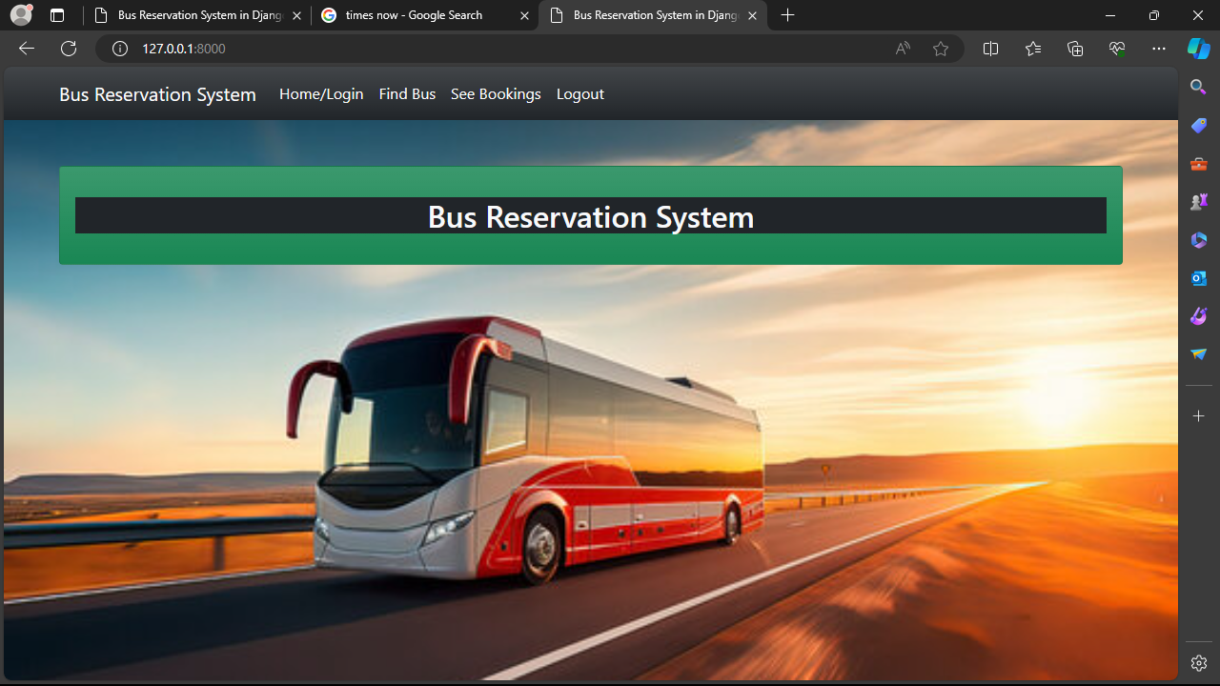
Homepage

Slide 12
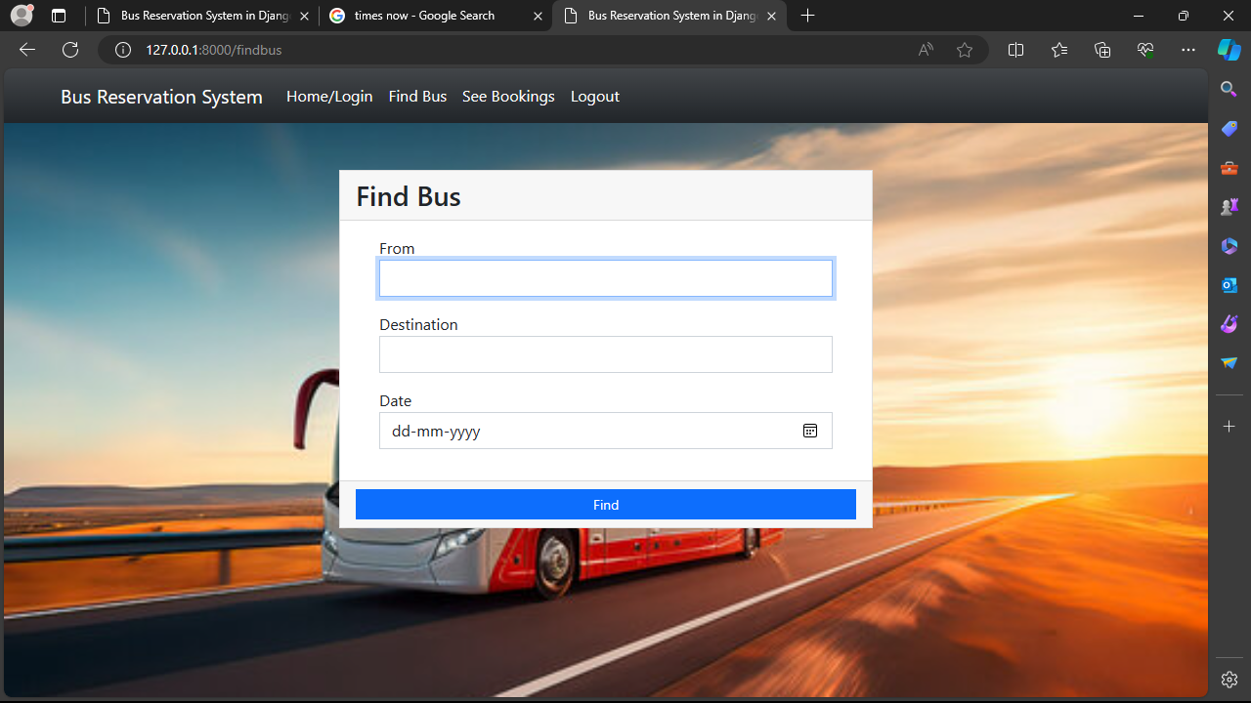

About-Us-Page

Slide 13
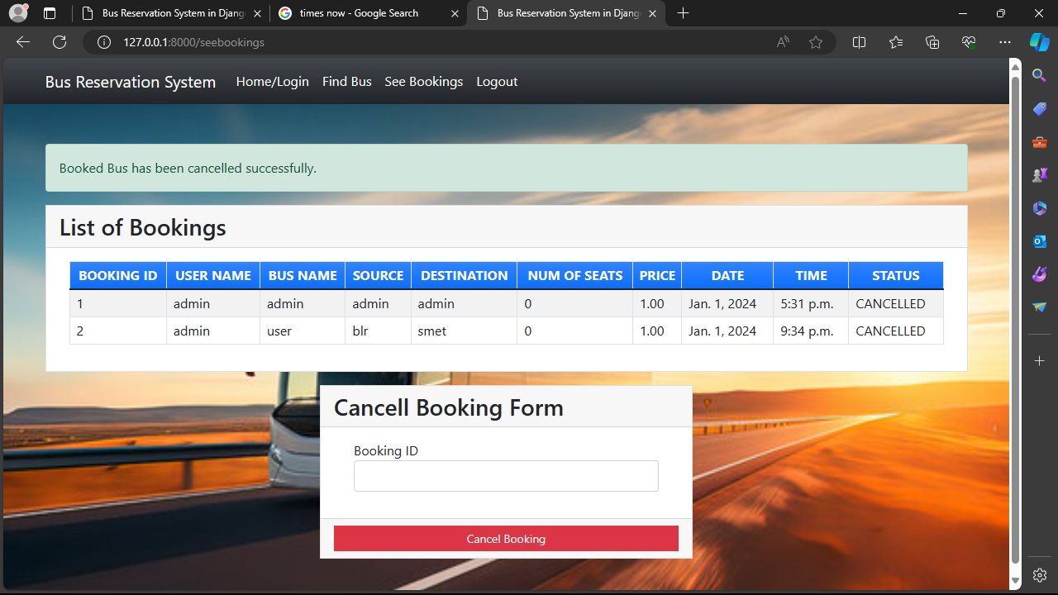
Service-Page

Slide 14
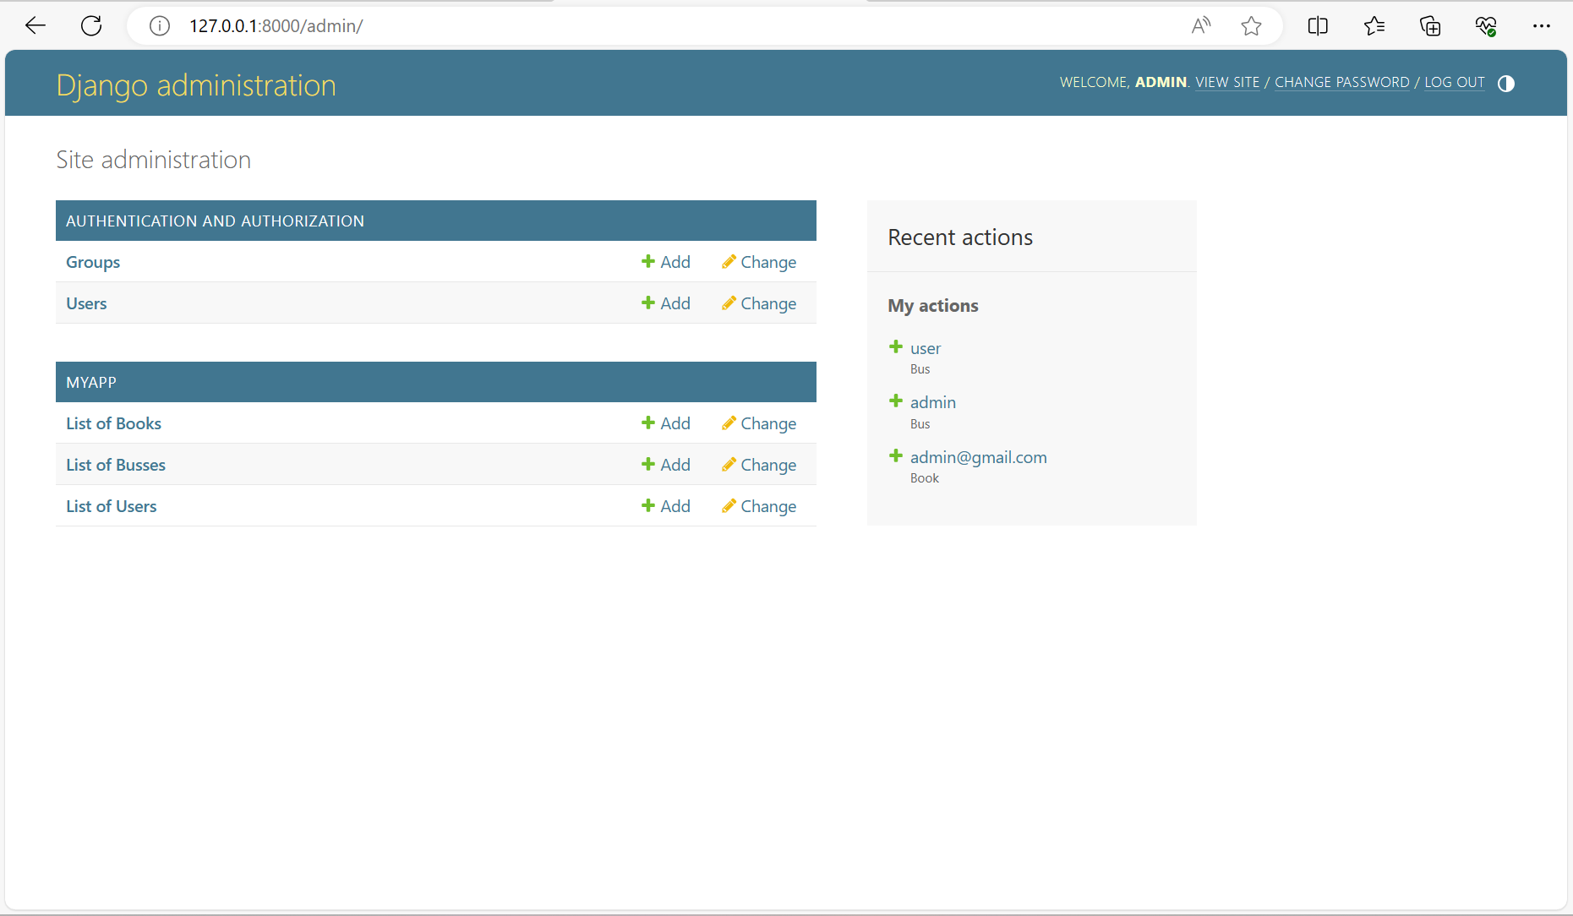
Departments-Page

Slide 15
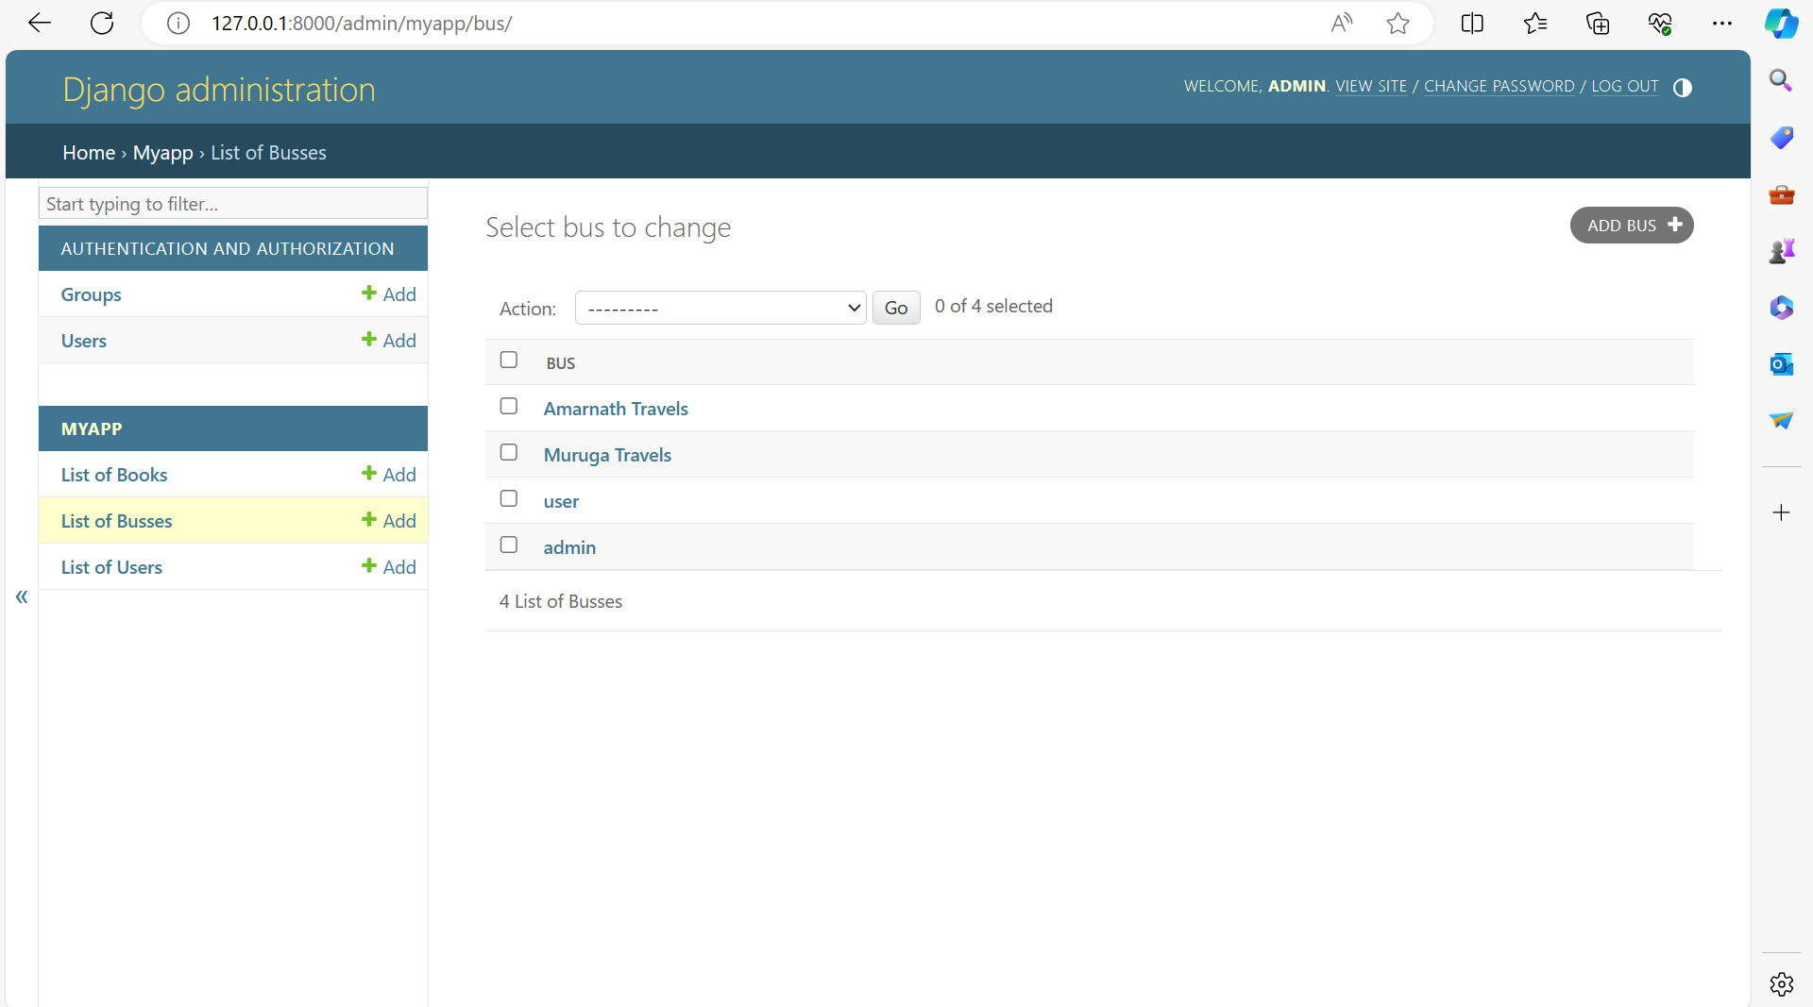
Blog-Page

Slide 16
Future Enhancements:
Mobile Application Development:
Develop a mobile application for both Android and iOS platforms to provide passengers with a convenient and accessible way to book tickets on the go.
Implement features such as push notifications, location-based services, and mobile wallet integration for enhanced user experience.
Dynamic Pricing and Offers:
Introduce dynamic pricing algorithms that adjust ticket fares based on factors such as demand, time of booking, and seat availability.
Implement promotional offers, discounts, and loyalty programs to incentivize repeat bookings and attract new customers.
Integration with Transportation Networks:
Expand the system's capabilities by integrating with other transportation networks such as railways, airlines, and taxis to offer multi-modal travel solutions.
Provide seamless booking experiences for passengers traveling across different modes of transportation.

Slide 17
Conclusion
The Bus Reservation System developed using Python and Django represents a significant advancement in the bus transportation industry, offering a modern and efficient solution for passengers and bus operators alike. Through the implementation of advanced functionalities and robust technologies, the system addresses key challenges faced by stakeholders and delivers a seamless booking experience while optimizing operational management.
By leveraging Python's versatility and Django's powerful web development features, the system provides a user-friendly interface for passengers to search for buses, select seats, make reservations, and securely complete transactions online. Real-time updates and notifications enhance transparency and communication, ensuring passengers are well-informed throughout their journey.
For bus operators, the system offers streamlined management tools to efficiently manage bus routes, schedules, fares, and bookings. Integration with payment gateways facilitates secure online transactions, while reporting and analytics capabilities provide valuable insights for optimizing operations and enhancing service quality.
Source :

Slide 18
Thank You!
Notes:
Thank You !!

